Slide 1


From Completion to Agentic AI The Evolution of Language models
Frederiek Vandepitte
Notes:
!

Slide 2

Agenda
The foundation
Conversational AI
Knowledge Enhancement
Tool Integration
Agent Orchestration

Slide 3

The foundation
How does it work?

Slide 4
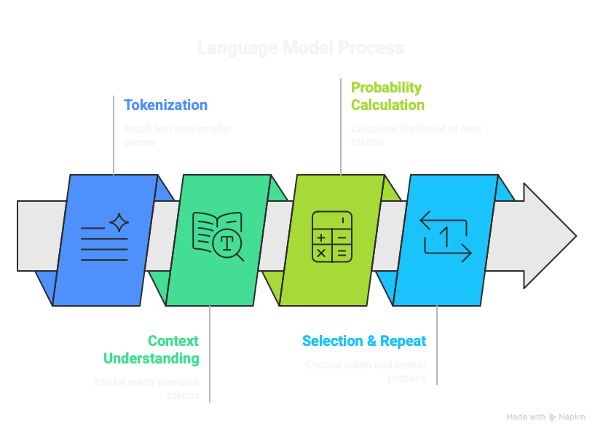

Slide 5

Probability Calculation
City | Probability
Brussels | 15%
Antwerp | 12%
London | 10%
Paris | 8%

Slide 6
Probability Calculation
Temperature
City | 0.0 - Deterministic | 0.7 – Balanced | 1.5 – Creative
Brussels | 100% | 15% | 13%
Antwerp | 0% | 12% | 13%
London | 0% | 10% | 12%
Paris | 0% | 8% | 11%

Slide 7
Probability Calculation
Top P(ercentage)
City | 8% | 10% | 14%
Brussels | 15% | 15% | 15%
Antwerp | 12% | 12% | -
London | 10% | 10% | -
Paris | 8% | - | -

Slide 8
Conversational AI
Remember the good old days?

Slide 9

Demo

Slide 10
Knowledge Enhancement
Bring your own data

Slide 11
RAG: Retrieval-augmented Generation
User Input
Normalize
Create Embeddings
Vector search
Tweak search parameters
Selet Top-N results
Build prompt
Send to LLM
Not enough results
Return answer

Slide 12
Tool calling
User Input
Send to LLM
Get answer
Is a tool call?
Return answer
Execute tool call with parameters
Select the correct tool

Slide 13
Demo

Slide 14
Agentic Orchestration
Let the AI do it’s thing

Slide 15


STATE OF THE ART
SOFTWARE

Slide 18


Slide 19


Slide 21


